Slide 1


ASP.NET State Management
Session State, Application State, View State
Svetlin Nakov
Telerik Corporation
www.telerik.com

Slide 2

Table of Contents
ASP.NET Intrinsic Objects
State Management in Web Applications
Cookies
Hidden Fields
Parameterized Addresses
Page Execution Lifecycle
ASP.NET State Management
Client side – View State
Server side – Application State, Session State
Manipulating the HTTP response headers

Slide 3



Intrinsic Objects in ASP.NET
Session, Application, Request, Response, …

Slide 4
Intrinsic Objects in ASP.NET
Intrinsic Objects in ASP.NET are available in the context of any Page or Control
Application (HttpApplication class)
Session (HttpSession class)
Request (HttpRequest class)
Response (HttpResponse class)
Server (HttpServerUtility class)
Context (HttpContext class)
Cache (System.Web.Caching.Cache class)
Notes:
Бележки на автора:
Вградени обекти в ASP.NET
Application (HttpApplication class)
Session (HttpSession class)
Request (HttpRequest class)
Response (HttpResponse class)
Server (HttpServerUtility class)
Context (HttpContext class)
Cache (System.Web.Caching.Cache class)

Slide 5
HttpApplication
HttpApplication keeps the application state
Provides access to other intrinsic objects
Properties Application, Context, Request, Response, Server, Session etc.
Provide events for:
Start of a new request
Authentication
Authorization
Working with the cache
End of a Request

Slide 6
HttpRequest
HttpRequest contains information about the current HTTP request
ApplicationPath – root path on the server
Browser – type, platform, capabilities, etc.
Cookies – get the cookies collection
HttpMethod – GET / POST
QueryString – e.g. ?id=7&lang=en
ServerVariables – IIS server settings
Url – the requested URL

Slide 7
HttpResponse
HttpResponse contains information about the HTTP response
ContentType – MIME type (e.g. image/gif)
Charset – response encoding, e.g. UTF8
Cookies – sets cookies
Expires – sets browser's cache expiration
BufferOutput – buffer or not the response
ClearHeaders(…), AddHeader(…)
Write(…), BinaryWrite(…), WriteFile(…) – send text or binary data to the client

Slide 8
HttpServerUtility
HttpServerUtility provides helper methods for processing HTTP requests
HtmlEncode(…) – escapes given HTML, e.g. "<img>" → "&lt;img&gt;"
HtmlDecode(…) – un-escapes escaped HTML
UrlEncode(…) – encode string for the browser URL, e.g. "+.net 4" → "%2B.net+4"
UrlDecode(…) – decode url-encoded string
MapPath(…) – returns the server-side path for given resource given as relative path

Slide 9
Intrinsic Objects – Examples
bool isSecureConnection = Request.IsSecureConnection;
Application.Add("key", "value");
string LabelResult.Text = Server.UrlEncode("Did you try ASP.NET 4.0?");
Response.ContentType = "text/html";
Response.Charset = "UTF-8";
string imageFileName = Server.MapPath("img/logo.gif");
string url = Request.Url;
string browserType = Request.Browser.Type;
Notes:
Бележки на автора:
Примерна употреба
bool isSecureConnection = Request.IsSecureConnection;
Application.Add("key", "value");
string strEncoded = Server.UrlEncode("Загорка");
Response.ContentType = "text/html";

Slide 10

Intrinsic ASP.NET Objects
Live Demo

Slide 11
Redirecting to Another URL
Response.Redirect("Login.aspx")
Client-side redirection (uses HTTP 302 Moved)
Lets the browser to request a new URL
Changes the URL address in the browser
Server.Transfer("WebTest.aspx")
Server-side redirection
Keeps the URL in the browser
The browser does not even know about the redirection
Notes:
Бележки на автора:
Пренасочване на изхода
Response.Redirect("Login.aspx") - Пренасочване от страна на клиента (client redirection). Променя адреса на Web браузъра.
Server.Forward("WebForm1.aspx") - Пренасочване от страна на сървъра (server redirection). Запазва адреса на Web браузъра. На практика Web браузърът не разбира за пренасочването.

Slide 12




Client and Server Redirection
Live Demo

Slide 13

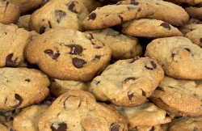

State Management: Standard Mechanisms in Web Applications
Cookies, Hidden fields, Parameterized Addresses

Slide 14
What is a Cookie?
A small piece of information (up to 4KB)
Sent to a browser by the Web server
Saved locally at the client as a text file
Sent by the browser in all subsequent requests
Sent as an HTTP header
Set-Cookie: UserID=baj.ivan; path=/; domain=devbg.org; Expires=Saturday, 17-Jan-07 00.00.01 GMT
Cookie: UserID: baj.ivan;

Slide 15
Cookie Properties
Cookies is ASP.NET are represented by HttpCookie objects
Expires
Sets when the validity of the cookie expires
Domain
A domain to which the cookie belongs
Path
Sets the top level directory to which the cookie belongs

Slide 16
Working With Cookies
For Web applications
System.Web.HttpCookie
For client applications
System.Net.Cookie
HttpRequest.Cookies contains the cookies received by the server
HttpResponse.Cookies contains the cookies sent to the client

Slide 17
Working With Cookies – Example
Creating a cookie that will be sent to the client Web browser:
Reading a cookie received at the server:
HttpCookie cookie =
new HttpCookie("UserName", "baj.ivan");
Response.Cookies.Add(cookie);
HttpCookie cookie = Request.Cookies["UserName"];

Slide 18
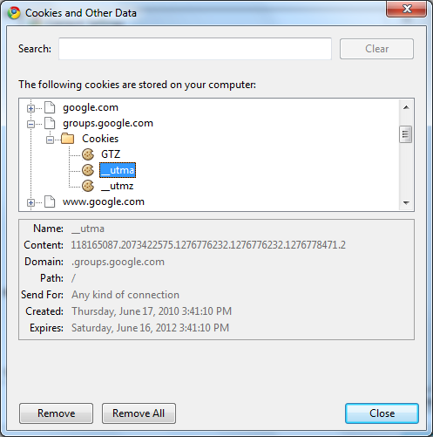


Cookies
Live Demo

Slide 19
What are Hidden Fields?
Hidden form fields keep information, not visible in the Web page, sent on form submit
ASP.NET HiddenField is a control, which renders as a standard HTML hidden field
Not visible in the browser, but you can use it to store information directly in the page
Insecure, because malicious user can easily access hidden fields and tamper it
<input type="hidden" name="Language" value="English">

Slide 20
Parameterized Addresses
Also known as query strings
Setting the parameters in the URL of a page after the ‘?’ sign:
Reading a query parameter:
Used to pass data from one page to another
Insecure, because malicious user can copy or change the address
http://asp.net/getstarted/default.aspx?tabid=61
string selectedTabID = Request.QueryString["tabid"];

Slide 21
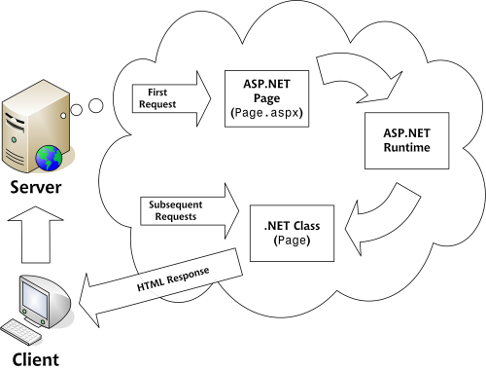
Page Execution Lifecycle

Slide 22
Page Execution Lifecycle
On the server side, ASP.NET web form goes through several stages:
Page framework initialization
User code initialization
Validation
Event handling
Automatic data binding
Cleanup

Slide 23
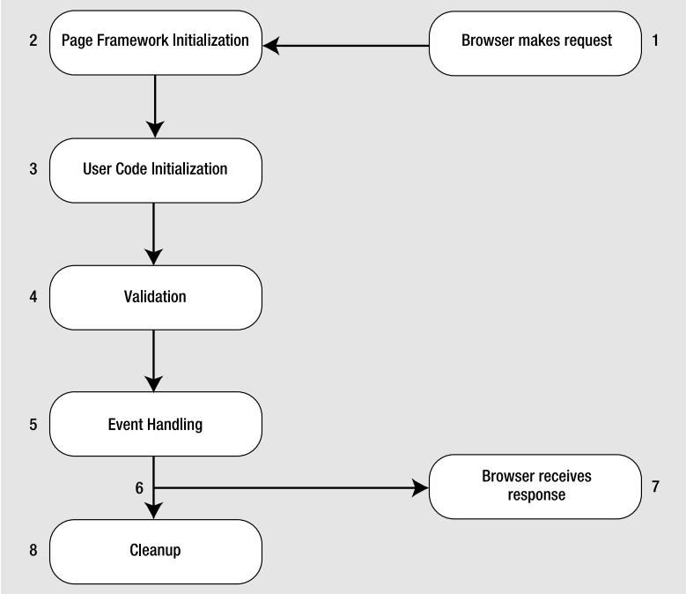
Page Execution Lifecycle (2)

Slide 24
Page Execution Lifecycle (3)
Page Framework Initialization:
Generates all the controls you have defined
If page is postback, ASP.NET deserializes the view state information and applies it to the controls
Page.Init Event fires
User Code Initialization:
Here you can perform any required initialization (e.g. filling in dynamic text or configuring controls)
Always fires Page.Load event
Page.IsPostBack – commonly used in it

Slide 25
Page Execution Lifecycle (4)
Validation:
All validation controls are checked and Page.IsValid property is set
Event Handling:
All Control Events such TextBox.TextChanged, Button.Click, Page.PreRender are triggered

Slide 26

Page Execution Lifecycle (5)
Automatic Data Binding:
After the Page.PreRender event fired
Data source controls executes theirs queries and insert the data into controls
Data source Selecting and Selected are fired
Cleanup:
At the end page is rendered as HTML and Page.Disposed event is fired

Slide 27


Page Execution Lifecycle
Live Demo

Slide 28

ASP.NET State Management

Slide 29
State Management
HTTP is a stateless protocol
In order to tell whether a request comes from a previous client we need a mechanism over the HTTP protocol
A number of standard ways to identify clients
ASP.NET offers both standard and upper level mechanisms to manage state

Slide 30

ASP.NET Based State Management
Client side
View state
Server side
Application state
Session state

Slide 31


ASP.NET Client Side State Management
ViewState

Slide 32
ViewState
ViewState keeps the state of the controls over several consecutive requests to the same page (postbacks)
Every change in the visualization of a control is saved in the ViewState
E.g. adding an element to a list control
Can save custom data defined by developers
ViewState["Username"] = txtUsername.Text.Trim();
lblUsername.Text = ViewState["Username"];

Slide 33
ViewState – Behind the Scene
Data saved in the ViewState is serialized and is sent to the client in a hidden field:
At postback the ViewState is deserialized and the state of the controls is restored
To accomplish serialization the ObjectStateFormatter class is used
<input type="hidden" name="__VIEWSTATE“ id="__VIEWSTATE"
value="/wEPDwUJODExMDE5NzY5D2QWAgIDD2QWAgIBDw8WA
h4EVGV4dAUFS296bW9kZGR67yT0OasTSUMlwIXGj65FNx7ggA==" />

Slide 34
ViewState Configuration
To disable ViewState
At page level
At control level
ViewState support encryption:
To save the ViewState at the server we can use SessionPageStatePersister
<%@ Page EnableViewState="false" %>
<asp:Label ID="lblName" Runat="server" Text="ligAZ"
EnableViewState="False" />
<%@ Page ViewStateEncryptionMode="Always" %>

Slide 35

ASP.NET Server Side State Management
Application State and Session State

Slide 36
Application State
The Application State is shared storage of information at application level
Store information in the memory of the server
Single object for all clients
HttpApplicationState
A dictionary collection accessed through HttpContext or Page
Available through all phases of the application lifecycle

Slide 37
Application State (2)
In order to have synchronized access we use the Lock() and Unlock()methods
Application State is rarely used in reality (unlike the cache)
Supported only for the sake of the pure ASP
Useful place to store small amounts of often-used data that is the shared for all users
Application.Lock();
Application["Users"] = (int) Application["Users"] + 1;
Application.UnLock();

Slide 38
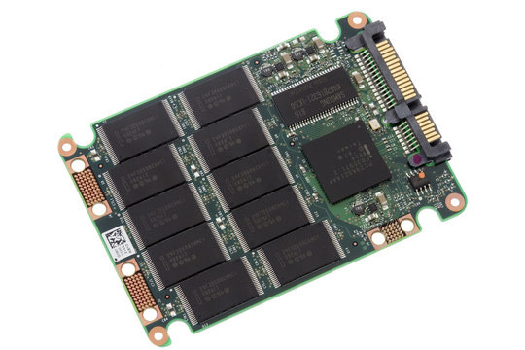

ASP.NET Application State
Live Demo

Slide 39
Session State
What is a Session State?
Storage of information at user level (different one for each user)
The Session is active:
Till the user closes the browser or
A certain period expires (20 minutes for example)
Every session is identified by a unique SessionID
Created at first entry in the site
Transmitted in a cookie by default

Slide 40
Session State (2)
The HttpSessionState dictionary collection is used through HttpContext or Page
To handle events fired when a session is started or ended we use Session_OnStart and Session_OnEnd in the Global.asax file
To deny/restrict access to the session
Session["username"] = "pesho";
string = (string) Session["username"];
<%@ Page EnableSessionState="False" %>
<%@ Page EnableSessionState="ReadOnly" %>

Slide 41
Session Configuration
We can configure various aspects of the session mechanism
Use the sessionState section in Web.config
Example:
<system.web>
<sessionState
cookieless="true" mode="InProc"
timeout="60" cookieName="MySite" />
</system.web>

Slide 42
Session Configuration (2)
Important attributes
Timeout
A period for which the session is active
Mode
Where the session is saved – in the current process, SQL Server, State Server (separate process)
Cookieless
A Session that doesn’t use cookies – SessionID is a parameter in the URL

Slide 43

ASP.NET Session State
Live Demo

Slide 44
Session – Recommendations
Use a wrapper class over the session
Don’t save too much information in the session
Don’t save lots of information in the ViewState

Slide 45
Manipulating the HTTP Response Headers

Slide 46
Manipulating the HTTP Response Headers
Part of the server response
Allow the server to pass additional information about the response
Page content, caching, cookies, http codes etc.
Give information about the server and about further access to the resource identified by the Request-URI
Accessible from code behind through Response.Headers collection

Slide 47
Manipulating the HTTP Response Headers (2)
Some response header members:
HeaderEncoding – sets header encoding
Headers – read only collection of headers
ContentType – HTTP MIME type of the output
Expires – numbers of minutes before page cached in browser expires
StatusCode – Http Status code of the output
AppendHeader() - Adds an HTTP header to the output stream

Slide 48
Manipulating the HTTP Response Headers – Example
Downloading image file generated from an ASP.NET page:
Response.Clear();
Bitmap generatedImage = new Bitmap(200, 200);
Graphics gr = Graphics.FromImage(generatedImage);
gr.FillRectangle(Brushes.MediumSeaGreen, 0, 0, 200, 200);
gr.FillPie(Brushes.Yellow, 25, 25,150, 150, 0, 45);
gr.FillPie(Brushes.Green, 25, 25, 150, 150, 45, 315);
Response.ContentType = "image/gif";
generatedImage.Save(
Response.OutputStream,ImageFormat.Gif);

Slide 49

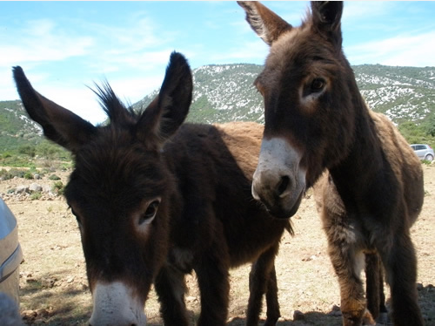
Manipulating the HTTP Response Headers
Live Demo

Slide 50
ASP.NET State Management
?
?
?
?
?
?
?
?
?
?
http://academy.telerik.com

Slide 51
Exercises
Create an ASP.NET Web Form, which prints the type of the browser and the client IP address requested .aspx page.
Create a ASP.NET Web Form which appends the input of a text field when a button is clicked in the Session object and then prints it in a <asp:Label> control. Use List<string> to keep all the text lines entered in the page during the session lifetime.
Create two pages that exchange user input data with cookies. The first page is a login page. The second one should redirect to the first one if there’s no cookie. The cookie must expire in 1 minute.

Slide 52
Exercises (2)
Create a JavaScript function that deletes the ViewState hidden field variable. What happens at postback?
Implement a graphical Web counter. It should display as JPEG image the total number of visitors of the requested .aspx page since the start of the Web application. Keep the number of visitors in the Application object. What happens when the Web server is stopped?
Re-implement the previous task to keep the total number of visitors in SQL Server database.

Slide 53
Exercises (3)
Implement the Tic-Tac-Toe game which allows Internet users to play one against another. Multiple game sessions should be supported to run in parallel. The main page (Default.aspx) should list all games in the application (games now playing, finished games and games waiting for a second player). The user could start a new game or join existing game which has only one player or view who is the winner of any finished game. When starting new game or joining an existing game, the player should enter his or her name. Players who wait for an oponent to join to their game or to enter a valid move should check repeatedly at 1 second.

